Slide 1
HR Analytics
Data Magnets - Thuan Tran & Chayse Summers

Slide 2
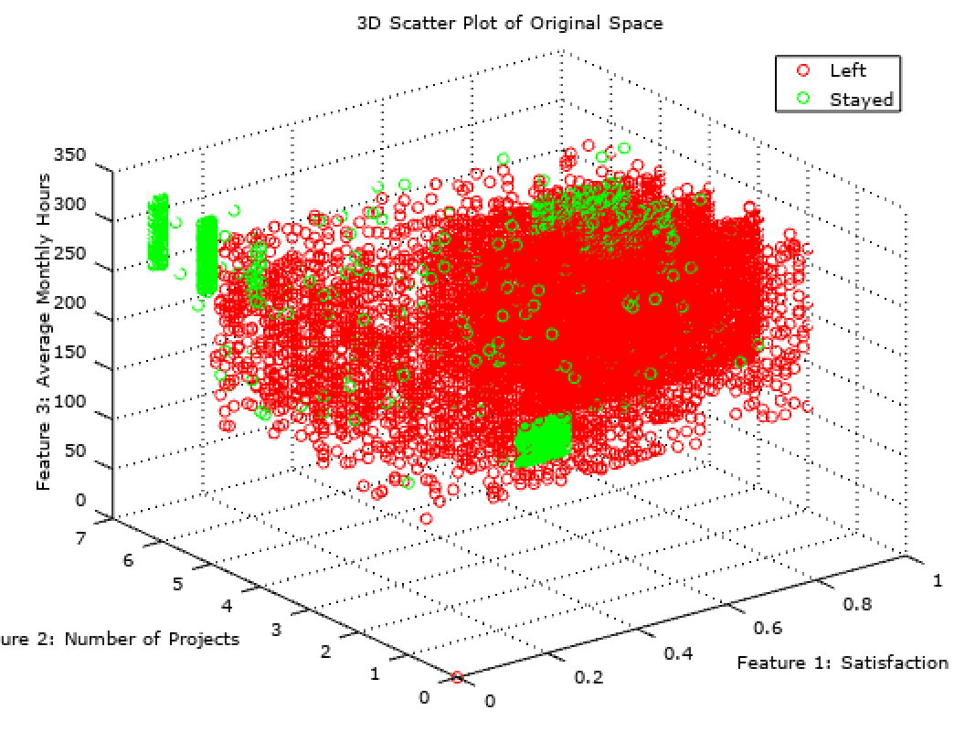
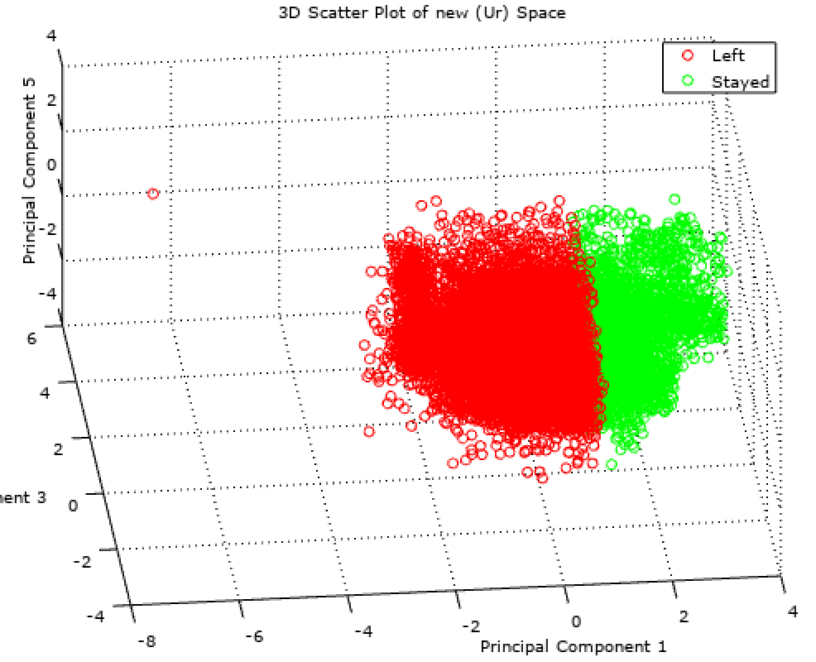
Principal Component Analysis

Slide 3

Classification Results MAGIC!
Bayes: 59% before PCA,
78% after PCA,
85% with Ur
KNN: 67% before PCA,
86% after PCA,
93% with Ur

